Slide 1
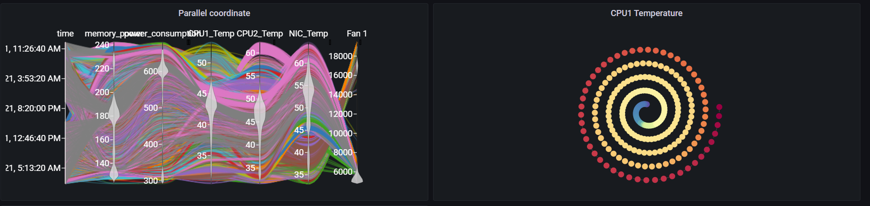
Grafana Plugin
Weekly report

Slide 2
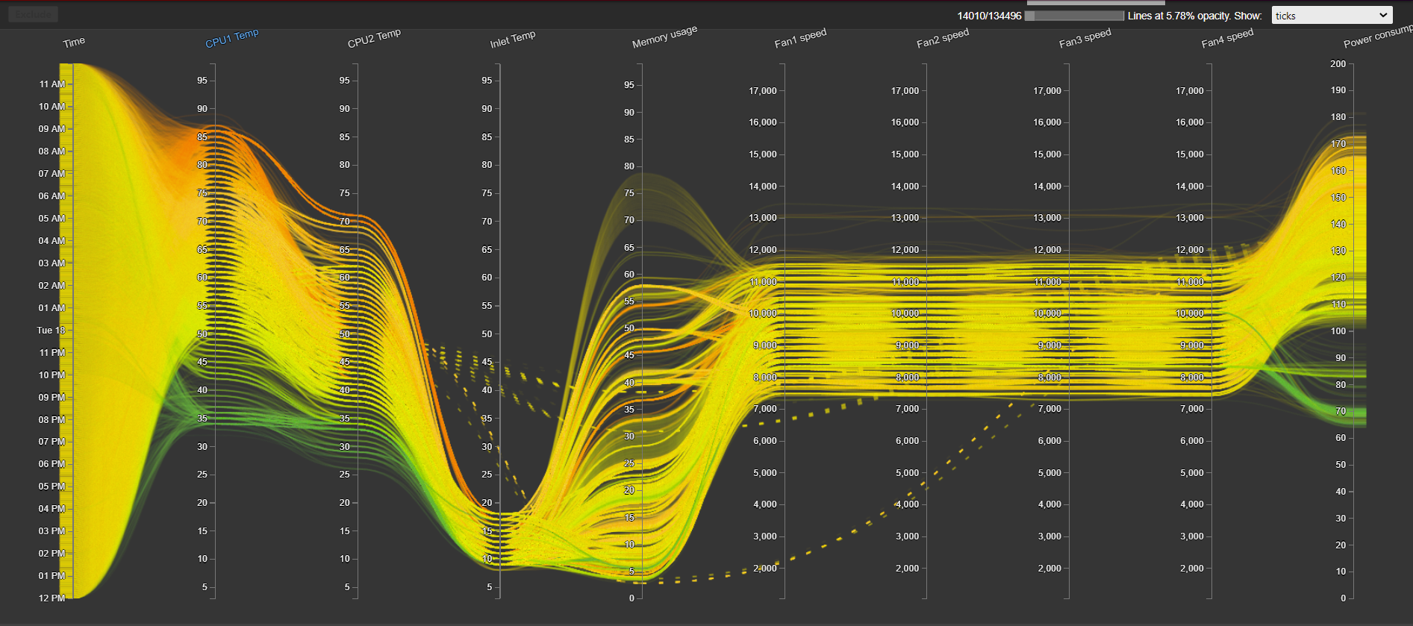
Original visualization
https://idatavisualizationlab.github.io/HPCC/ParallelCoordinates/index.html

Slide 3
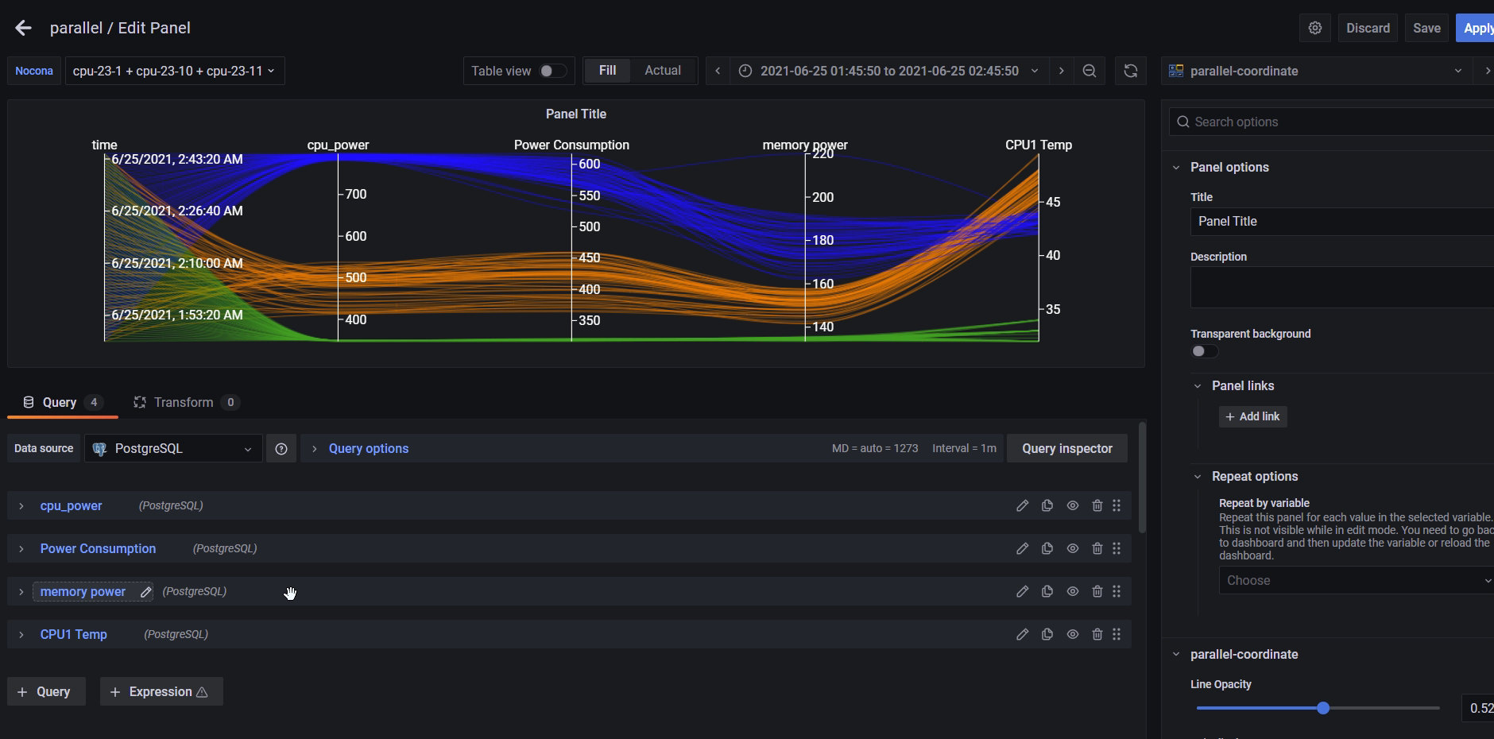
Previous result

Slide 4
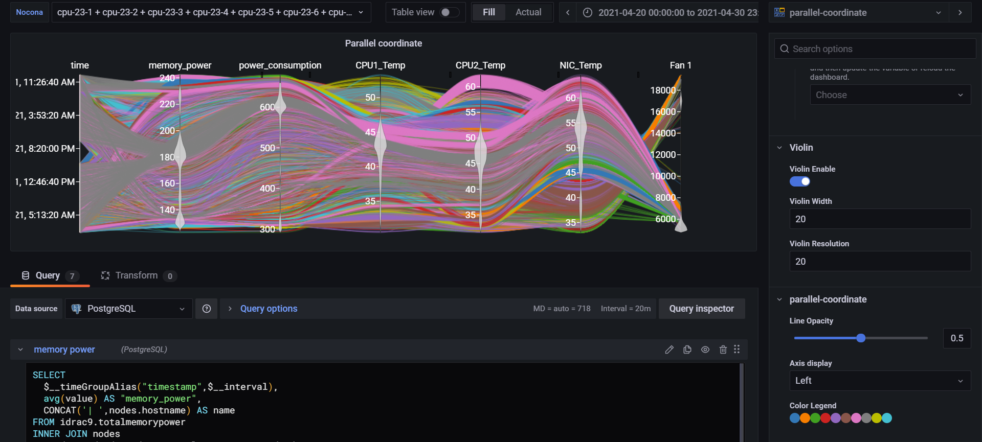
Current result
Primary app: https://idatavisualizationlab.github.io/HPCC/ParallelCoordinates/index.html

Slide 5
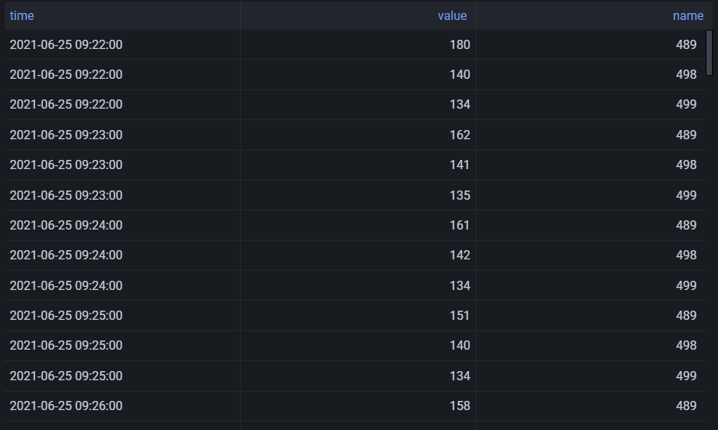
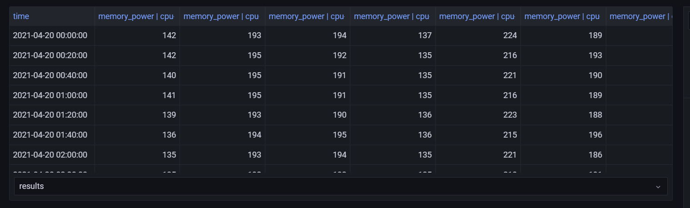
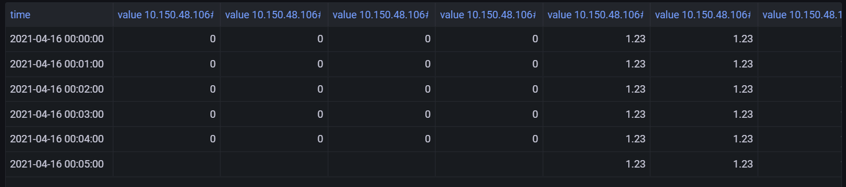
Current result
a) Format for id as number
b) Form multiquery format
metrics_name|nodeID
c) Single query format
nodeID|metrics_name

Slide 6
Current features
Violin summary on each axis
Show node information when filter
Reformat color legend

Slide 7
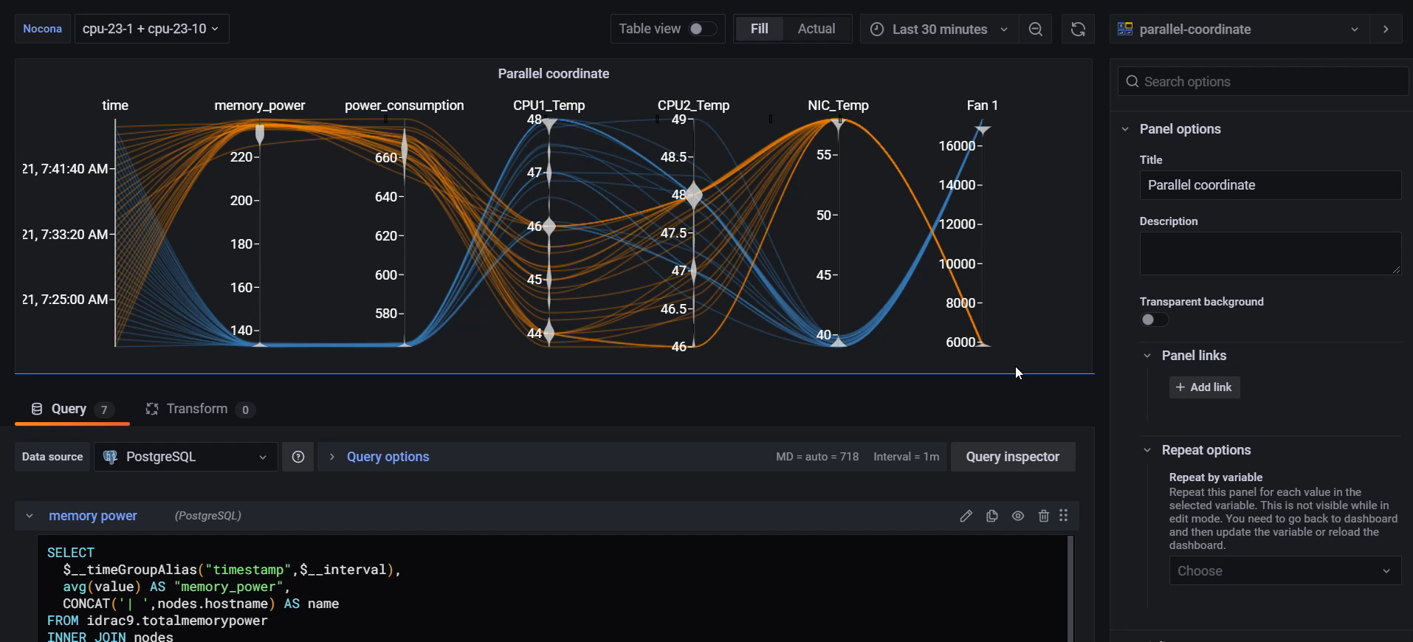
Current features

Slide 8
Future features
Color by Metrics (current color by compute)
Rendering by sequences
Dimension statistic (avoid showing single/ double unique values)

Slide 9
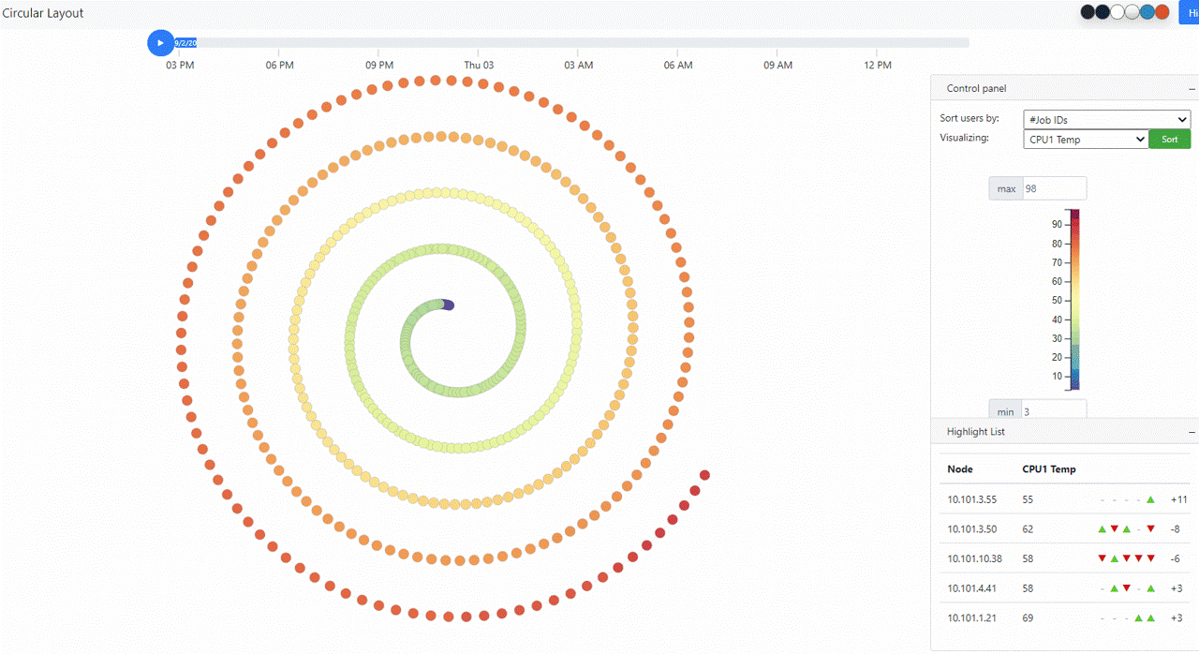
Original visualization
https://idatavisualizationlab.github.io/HPCC/spiralLayout/index.html

Slide 10
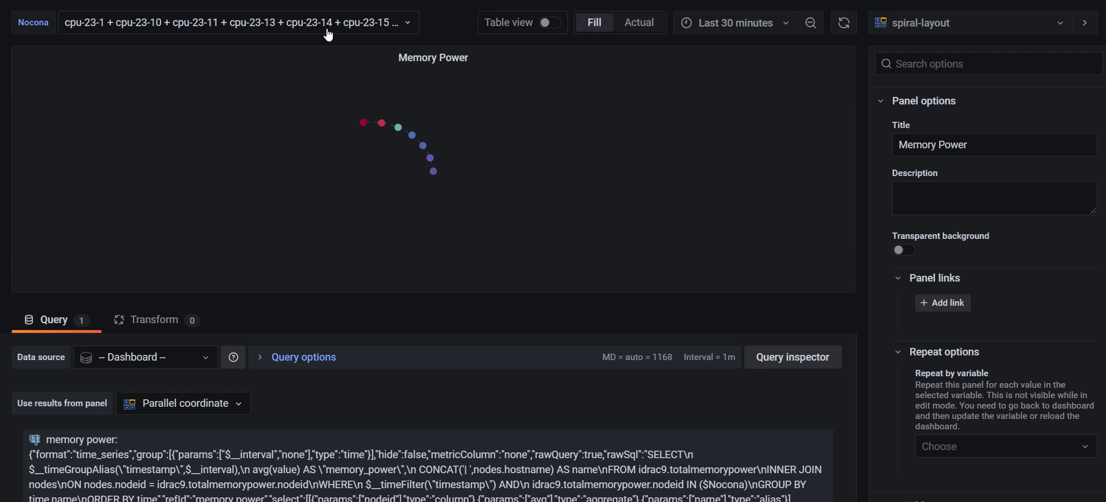
Current features

Slide 11
Future features
Selectable time range
Selectable metric
Trajectory (heatmap)

Slide 12
Job related data
Able to query job data with the query by time and running node:
SELECT *FROM slurm.jobsWHERE start_time < ${__to:date:seconds} AND end_time BETWEEN ${__from:date:seconds} and ${__to:date:seconds} AND ARRAY[${Nocona:csv}] && nodes

Slide 13
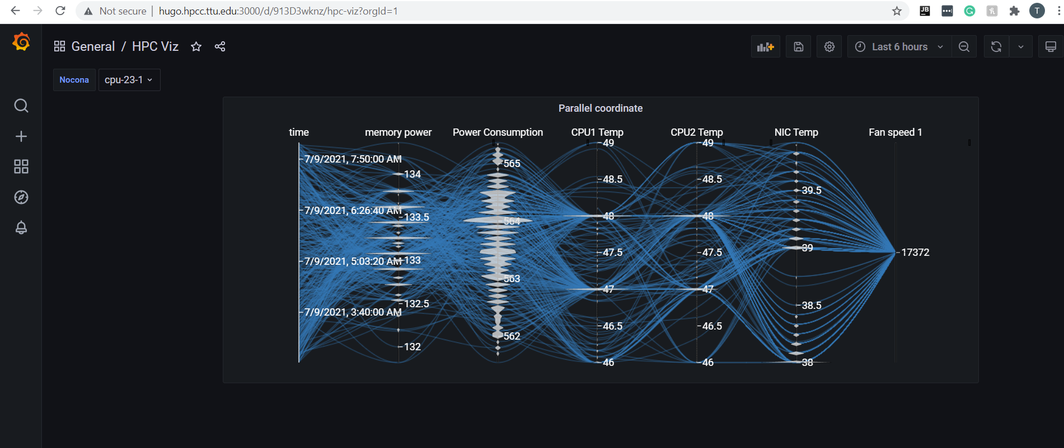
Install on systerm
Install unsigned version on hugo.hpcc.ttu.edu

Slide 14
Challengs
Not figure out where is the Job information locates in DELL database
Transfer code from javascript to Typescript take time

